Slide 1
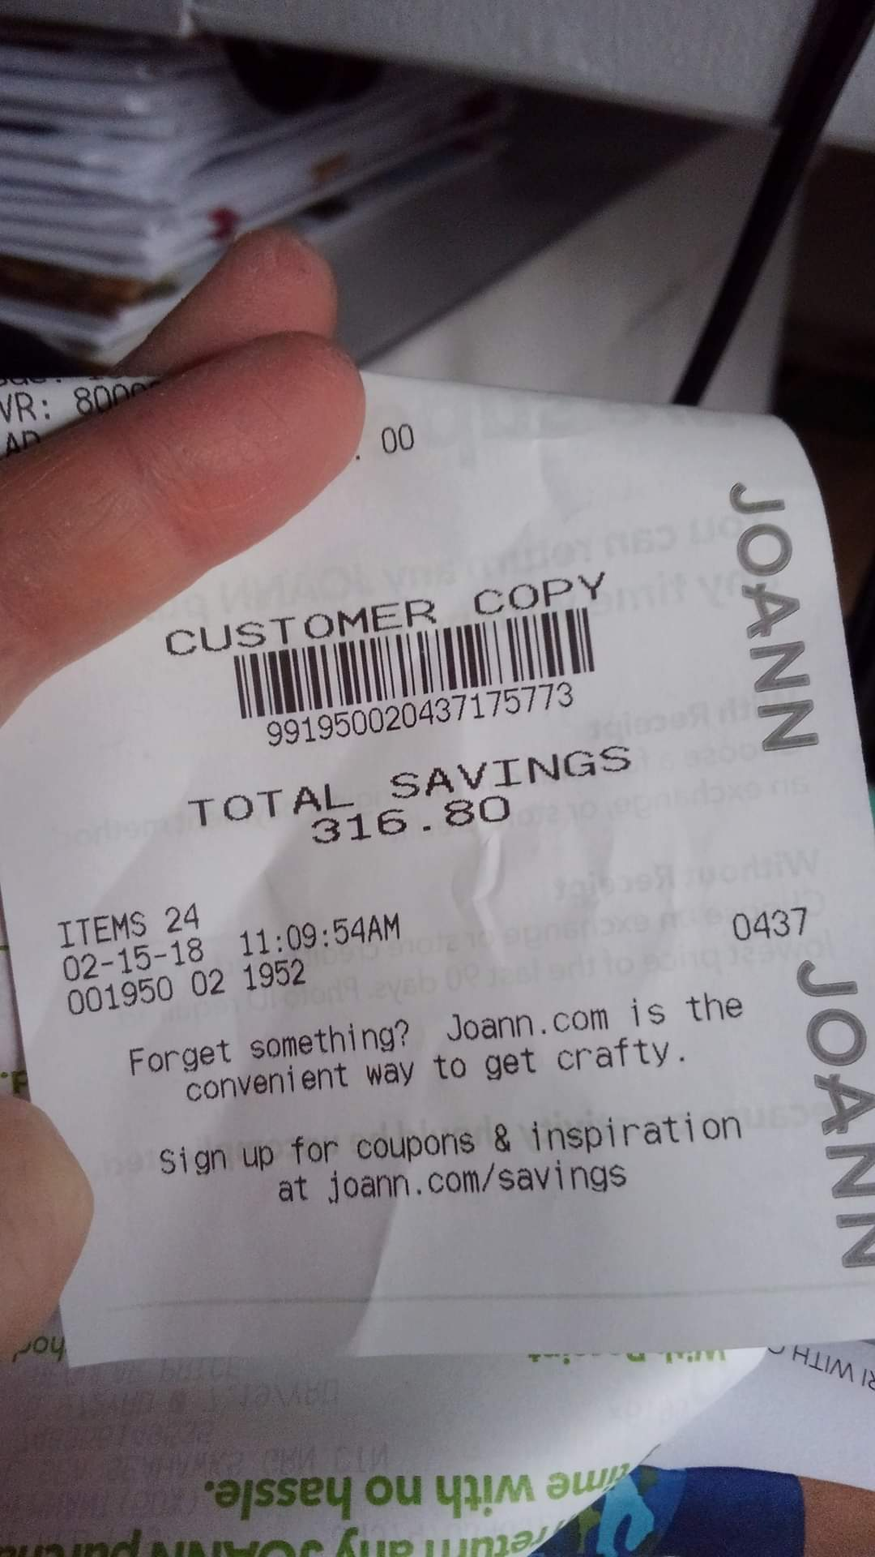

Cosplay on a Ramen-level budget
aka how to cosplay when you’re flat broke
Find the slides at
Notes:
Introduction
Yes, that is a real receipt lol.
I’m pretty sure I’m the reason the local Joann doesn’t have super sales anymore.

Slide 2

Cosplay budget misconceptions
Requires a massive budget
Don’t ask me how much I spent on this lololol
Needs expensive tools
Must have tons of space!
Lol you can’t do contests with budget materials hahahaha
Why can’t we just have fun cosplaying characters we love?
Actually you can!
Notes:
When I started, cosplay involved drug-store wigs, duct-tape Final Fantasy dresses, and cardboard Gundams.
Cosplay is a huge expensive industry now, and that puts up barriers. But they’re false barriers.
Don’t worry. There are many options to cosplay on a budget.
Let’s talk about ways to become a budget pro and not look broke
You can even compete in recycled cosplay!

Slide 3
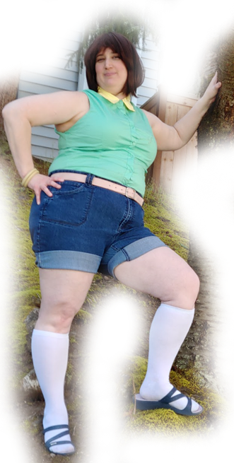
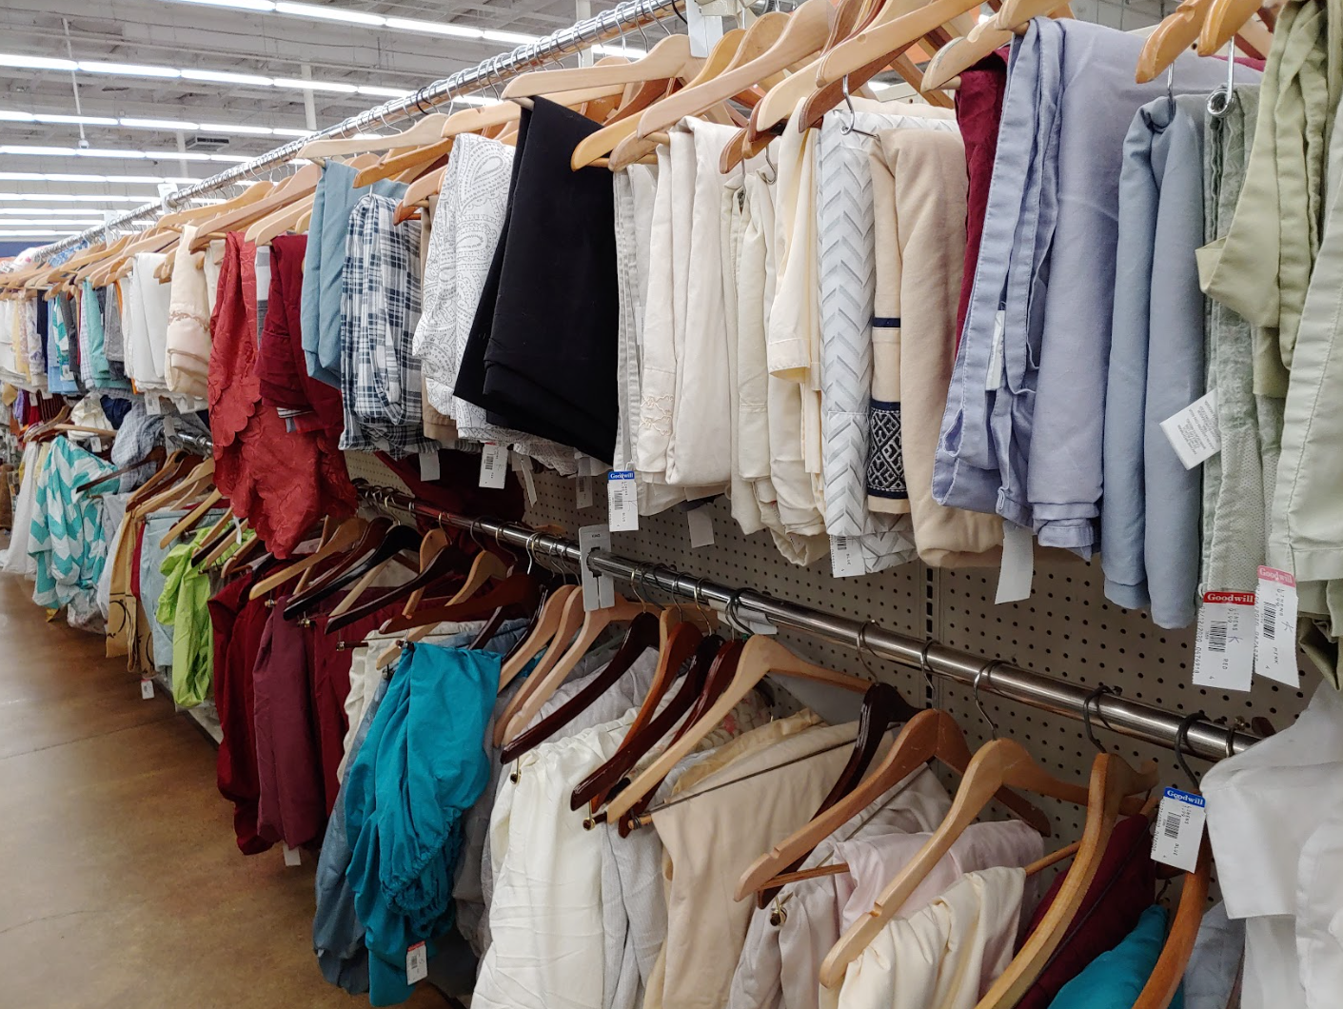
The art of thrift
Find pieces for casual clothes or school uniforms
Good for a quick cosplay find
Halloween brings in wigs, props, and costumes
Cheap materials and fabrics
Reuse and recycle!
Amazon wig
Thrifted shirt $3
Walmart bracelets
Thrifted shorts $3
Socks and shoes I already own
Téa for fun! Cost about $12
Notes:
Thrifting is great for cheap supplies and you reuse stuff instead of making more waste!
What can you do with a thrift store?
Gold mine for casual clothes and school uniforms
Halloween is the best time to search for props and wigs and premade costumes (I’ve donated costumes before!)
Good for materials and fabrics
Find patterns, machine parts, thread, and even full machines!
For Tea, I used a lot of what I owned and modified the shirt only a little bit.

Slide 4
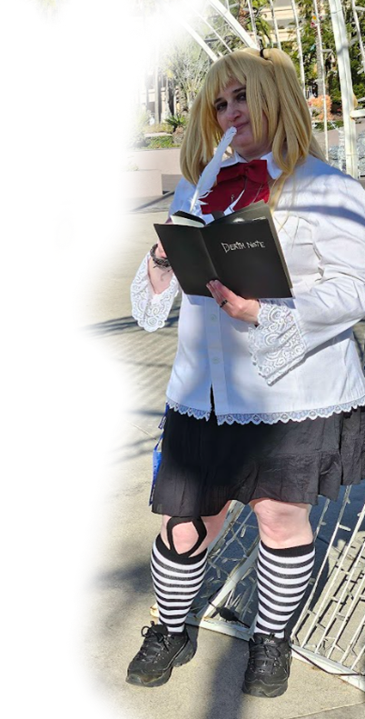
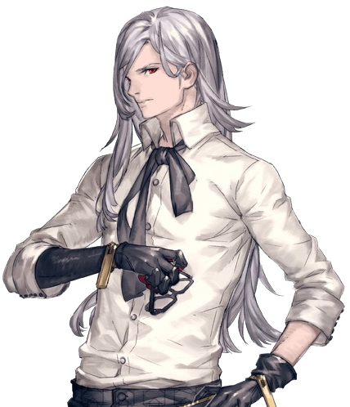


More recycling… from your closet!
Death Note from AliExpress
Reuse old cosplay pieces
Use stuff you own
Mix and match with created or thrifted pieces
Combine with other budget things for a full cosplay!
Good for casual clothes, street clothes, and school uniforms
Cheap Amazon gothic jewelry
Scrap fabric
Stretch lace bought in bulk
Socks and shoes I already own
Misa-Misa cost about $25
Notes:
Thrifting is great for cheap supplies and you reuse stuff instead of making more waste!
What can you do with a thrift store?
Gold mine for casual clothes and school uniforms
Halloween is the best time to search for props and wigs and premade costumes (I’ve donated costumes before!)
Good for materials and fabrics
Find patterns, machine parts, thread, and even full machines!

Slide 5
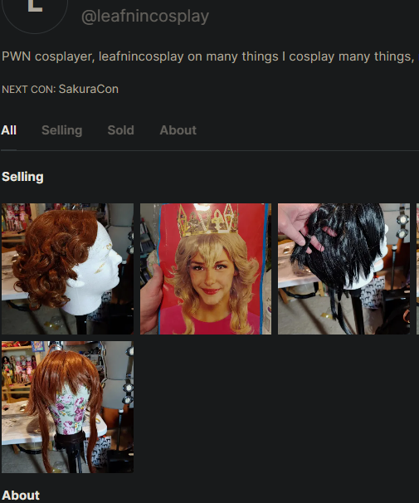

Buying second hand
Can’t afford something new? Why not go second hand?
Lumikha Cosplay
Coscove
LumikhaCosplay.com
Coscove.com
Notes:
I sell second hand on Coscove myself. They’re women- and minority-owned small businesses. You can find all sorts of gems here.

Slide 6
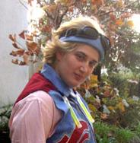
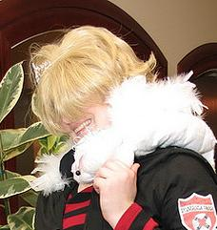


Getting budget wiggy
Budgeting options
Style your real hair
Hit up thrift stores and halloween stores
eBay, Amazon, and AliExpress for budget
Nicer quality:
  Assist Cosplay https://www.assist-wig.com/ (JP) – group order with a proxy. Often have BOGO sales
  Coscraft https://coscraft.co.uk/ - no proxy needed
  Swallowtail https://swallowtail-wig.com/ (JP) – group order with a proxy
  Arda wigs https://arda-wigs.com/ (US) – discount and sales are nicely priced!
How to make most of your wigs
Buy multi-purpose wigs
Style them yourself. Add braids, clip ins, or ponytails to customize
Store them in a bag and wig net to make them last
Same wig?! It only cost $10?!
Accessories make the difference!
Braided Lulu myself
Won best advanced at KingCon 2020
Notes:
Wigs are often your most expensive piece, but you can still get thrifty with your wigs.
Budget options
Use your hair.
Thrift stores and halloween stores
Be careful with eBay, Amazon, and AliExpress. Always read reviews before buying!
Nicer quality ones. You know what you’re getting in terms of appearance and quality. Can be used as multipurpose
How to make the most of your wigs.
Multipurpose wigs. Reuse for multiple characters
Style it yourself! Stores mark up prices for styled or character wigs. Go generic!
Store them properly to make them last super long

Slide 7
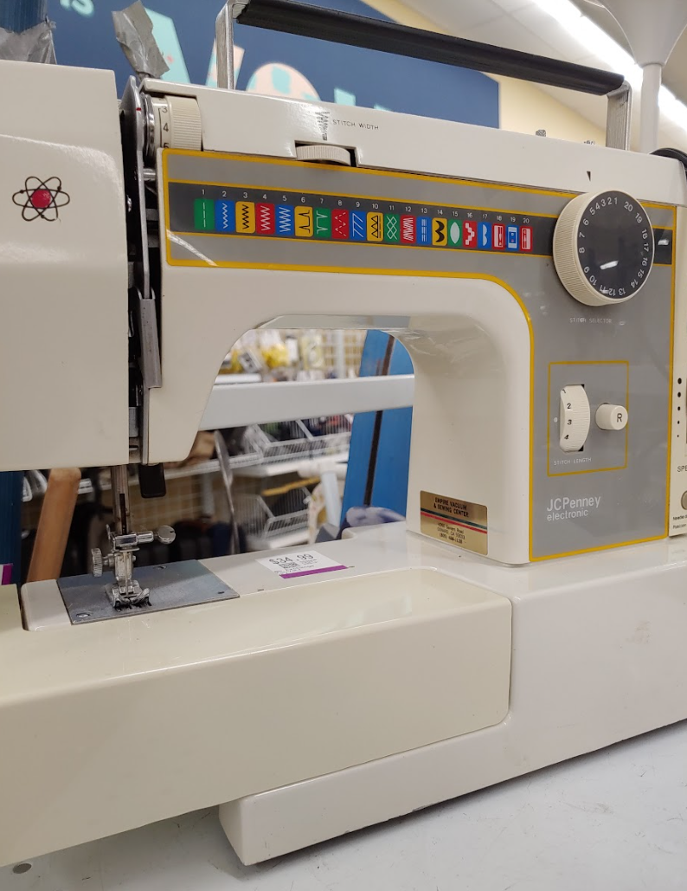
Budget sewing equipment
Sewing equipment can be expensive unless you’re a budget master
2nd hand machines
  Thrift stores, 2nd hand industrial machines
Budget machines on Black Friday
Walmart has your cheapest machine notions, scissors, velcro, and elastic
Check your library’s makerspace!
You need only a few things to get started
Sewing machine + universal needles
Thread (get good thread. Trust me)
Scissors (thread + fabric)
Pins & pin cushion
A bottle of basic machine oil
Iron with board or thick towel (recommended!)
When you sew, you can thrift it
Notes:
Retail once again marks up supplies.
Modern machines are easiest to learn on. Brother and Singer are budget basics and can last you years if you take care of it
Check out thrift stores, estate sales!
Industrial machines are indestructible but you need space for them
Vintage scene if you want to repair your own (it’s fun!)
Surprisingly Walmart is cheapest for buying sewing machine notions. Joann and Michaels mark them up, so only go during notion sales
You don’t need much to get started!
Check out the list of basic supplies

Slide 8
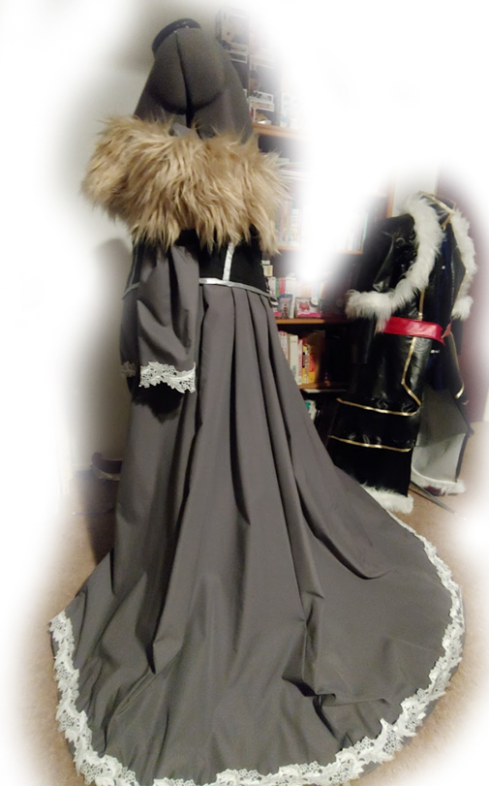
Fabrics on a budget
Never shop retail or Amazon.
Go wholesale
Physical stores
Fabric districts
Wholesalers on eBay
  Sy Fabrics
  Fabric Wholesale Direct
  Thread Art
  Fabric Wholesale Empire
  Stylish Fabrics (best jersey for cheap!)
Thrift it!
Linens, curtains, and bedsheets
Harvest fabric from prom dresses
Rugs and carpets for fluffy things
Tablecloths look like leather
Anything that looks like fabric can become fabric!
tablecloth
Couch throw
Curtains
Notes:
Retail marks it up. Become a coupon queen, king, or themperor
Wholesale saves you money!
So does thrifting! It’s not just buying fabric scraps, it’s repurposing
Bedsheets - Cotton, jersey, even flannel sheets. Can use quilts for batting
Curtains can give you a huge variety of materials. - lace, sheers, cotton prints
Fluffy rugs are great! The new GoT show used Ikea rugs for capes so you can too!
Tablecloth vinyl is great leather
Harvest fabric from old prom dresses, wedding dresses, and other clothing
If it’s fabric, it can be sewn!

Slide 9
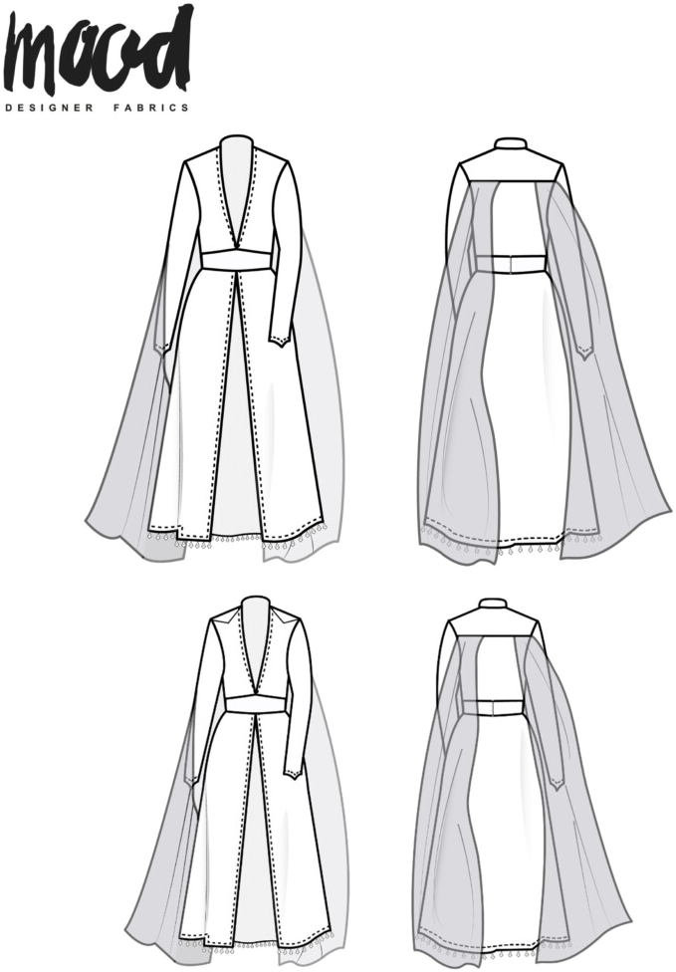
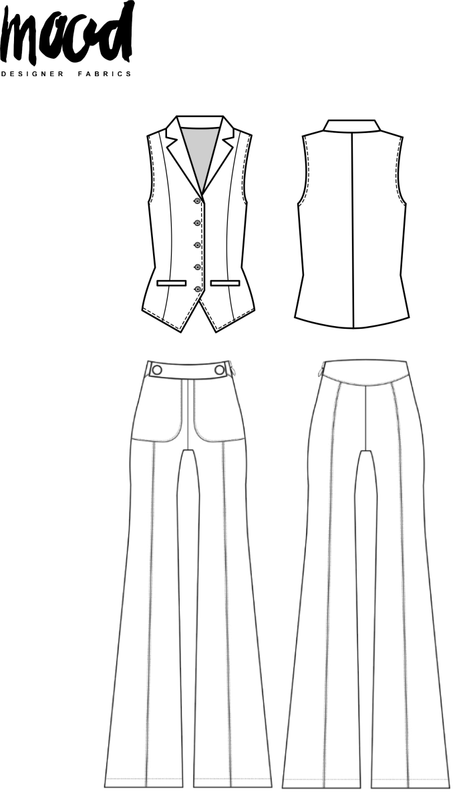
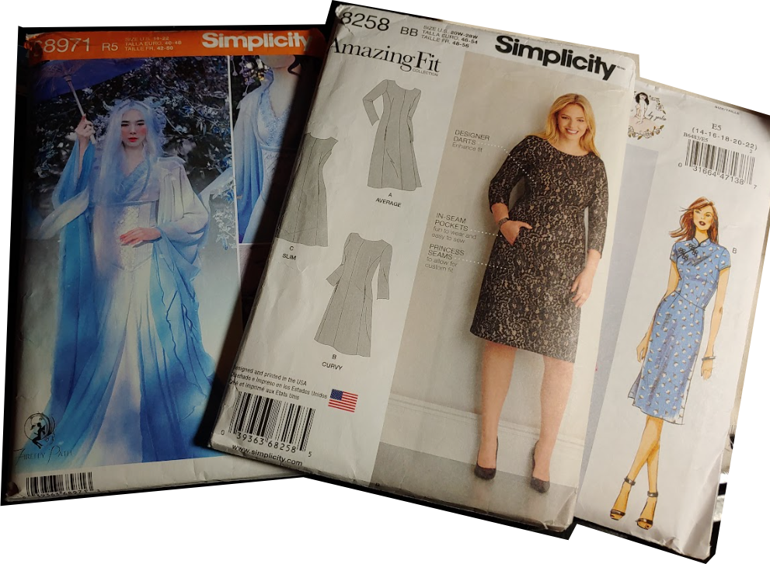
Patterns on a budget
Never buy full price
Joann pattern sales - $2+/pattern!
Simplicity.com pattern sales - $5+/pattern!
Thrift it!
Cheap used patterns on eBay
Mood Sewciety – FREE?!
  Size inclusive
  Gender inclusive
  There are cosplay patterns!
  Did I mention free?
Let me tell you about my friend, Mood Sewciety
Combine patterns you have to make new ones!
Notes:
Patterns are even more expensive that fabric but they don’t have to be
I own over 200 patterns and counting. I bought all of mine on sale. I’m pretty sure I should be banned from Joann

Slide 10

Sewing tips
Crunchyroll Expo Cosplay Cup finalist, 2022. $150
Suncatcher
Notions
Buy good thread. Do not skimp on this
Buy buttons, eyelets, and rivets in bulk
Buy spools of snap tape and bias tape, not tiny packages from Joann or Walmart
Trim, lace, and notions are cheap from wholesalers on eBay
If you can wait, buy trim from AliExpress
Fabric
Buy wide widths
Stick with cheaper fabrics like voile, cotton, and jersey
Avoid costume satin at all costs
Be careful of too many synthetics!
Cord elastic
Bulk party beads, 10yd
Bulk Xmas bead garland
10yds
Macrame cord
Synthetic chiffon
Graduation tassels
Synthetic silk shantung
Notes:
When it comes to saving money with sewing, it’s good to know where you can save money and what not to skimp on.
Notions
------------------
The biggest “do not skimp” is thread. Coats & Clark will break on you, and cheap thread will pop stitches right in the middle of a con.
Joann has constant thread sales. Buy giant spools of Gutterman and save yourself a headache.
Cleaning and tailoring supply shops will give you massive discounts on thread, much like a wholesaler does with fabric.
Buying in bulk for buttons and other similar notions will save you time and money. Most places on ebay and sometimes on amazon will offer a huuuuuge bulk discount
Button jars at walmart will get you a ton of buttons for a cheap price
Buying in bulk means a little bit of a cost up front but not having to buy supplies for later.
Do this for common things. Don’t go out and buy some specialized buttons you’ll never use again
I use a ton of bias tape. You can buy them by the spool for like $10 and have 100 yards. It will take you a ton of time to get through them, but it’s cheaper than buying all those packets.
eBay has a ton of wholesalers and cheap chinese sellers. You can find all sorts of beautiful lace and trim for a good price if you’re willing to wait for shipping.
Fabric
--------------------
Wide width fabric is easier to find in wholesalers. If you look at the back of a pattern, you’ll often see that you need less fabric when you get a wider width. Fewer yards can save you money.
Some fabric comes up to 108” depending on the type but most will come at 60” width
Synthetic alternatives are often cheaper. Synthetic silk can cost $5-10 a yard, depending on type, whereas real silks will cost you upwards of $30 or more a yard.
Lang as the example used over 30 yds of fabric, 20 yds of beads, and I lost count how much cording. Can you believe all this was only $150?

Slide 11
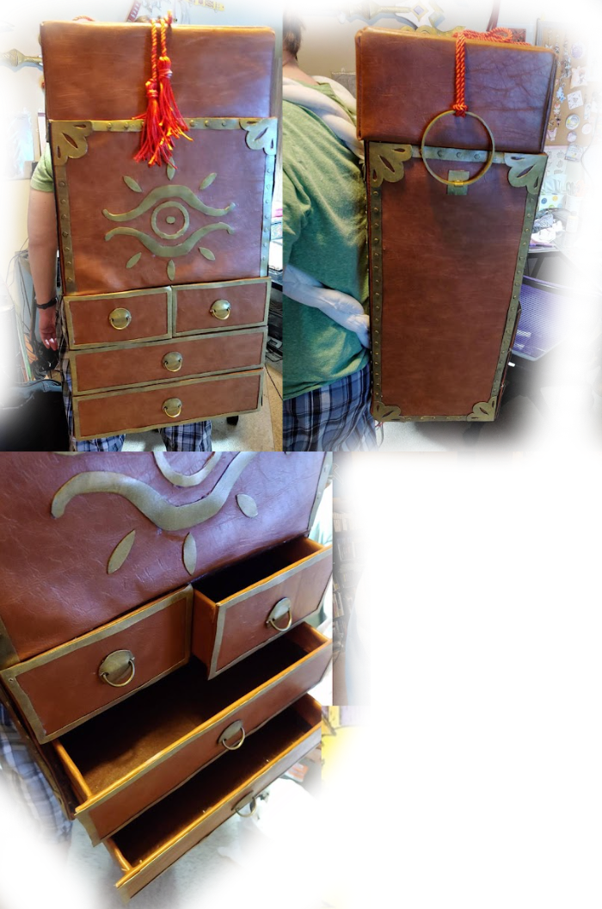

Budget props - cardboard & foam core board
Cheap to get - check craigslist!
Can be surprisingly sturdy!
Cover with materials to make it look expensive
Styrofoam ball
Cardboard wrapped in upholstery vinyl
Embroidery hoop
Foam core board
Foam details
D-rings bought in bulk
Felt lined cardboard drawers
Shower curtain rod
First place props winner - Norwescon 2018
Notes:
Cardboard can go a long way. I love cardboard. I have a collection. It might be a problem.
Both of these were contest entries!
Scythe - Foam core board and a shower curtain rod
Backpack - Cardboard, felt, and upholstery vinyl
The foam and felt used here are just cheap $1 Walmart sheets

Slide 12
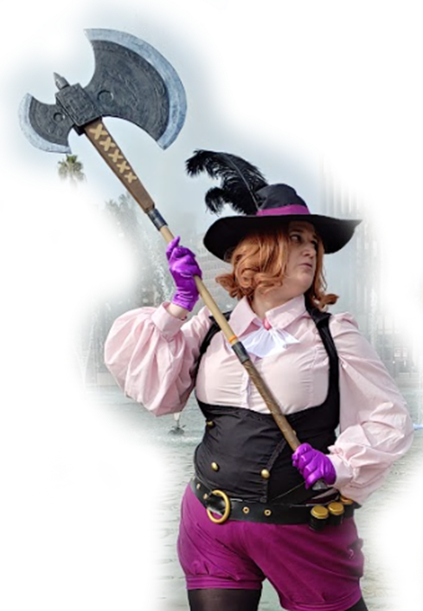
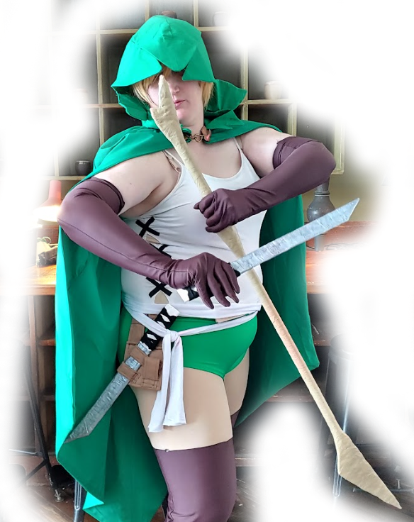
Budget props - paper mache & decoupage
Cheap and easy to work with
Indoor safe!
Use Mod Podge! It’s longest-lasting
Can use paper or fabric
Bases can be anything! tin foil, curtain rods, cardboard boxes, foam core board
Amazon boxes
Paper mache: Applying newsprint or similar paper with a brush or fingers
Cocoa box details
Decoupage:
Applying fabric or designs with a foam sponge
Long soda can box
Foam core board
Strips of tissue boxes
PVC pipe & foil
Notes:
Stick (left) - foam core board, pvc pipe, aluminum foil, fabric strips, and glue
Noir’s Axe (right) – PVC pipe, amazon box, 6 cocoa boxes, 2 cereal boxes, and a soda box

Slide 13
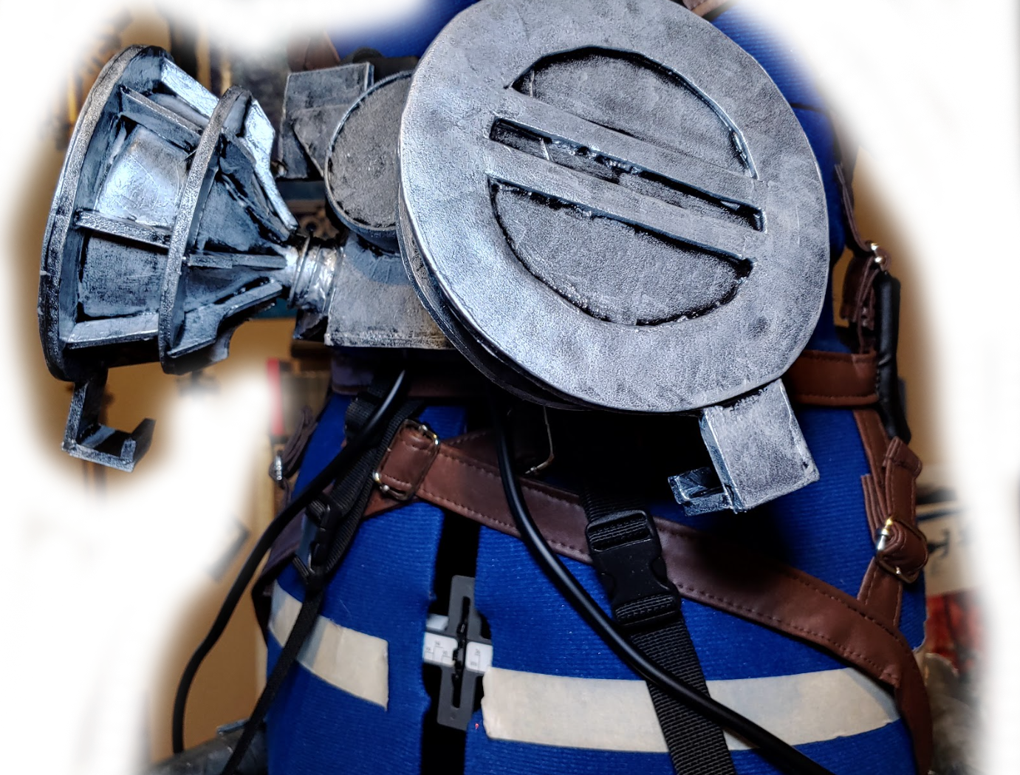
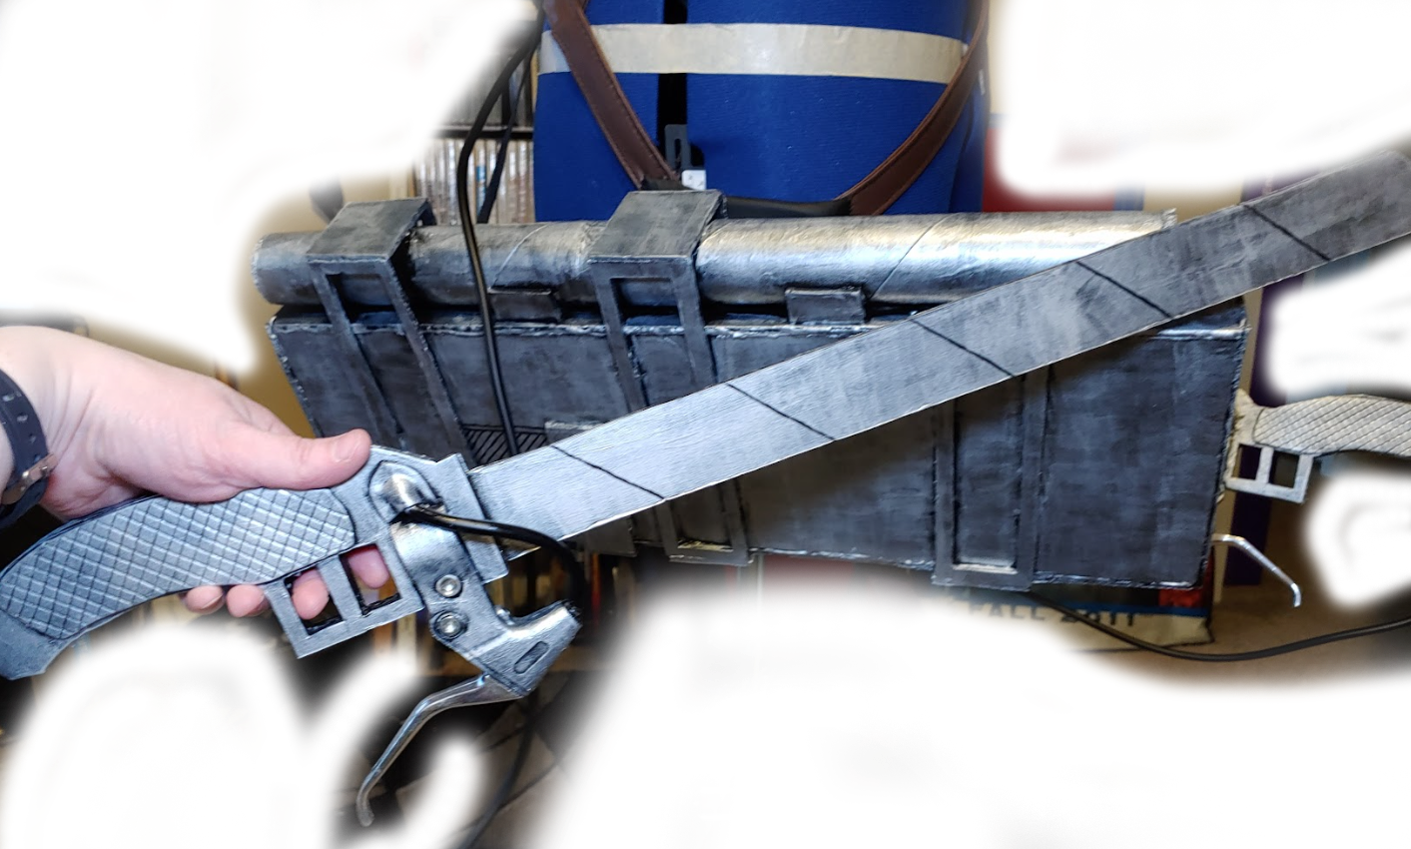
Budget props - other materials
Get creative!
Transform weird materials into something cool
Use a bunch of materials together!
Top of a peanut jar
Top of 2L soda bottles
Paper towel tubes
Foam core board
Aquarium tubing
Backpack strapping
Foam details
2nd hand bicycle break handles
Notes:
Materials for props
You can literally make props out of nearly anything!
This ODM gear contains some of the weirdest materials I’ve used in props

Slide 14
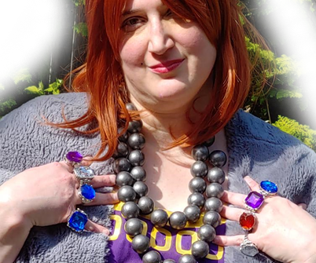

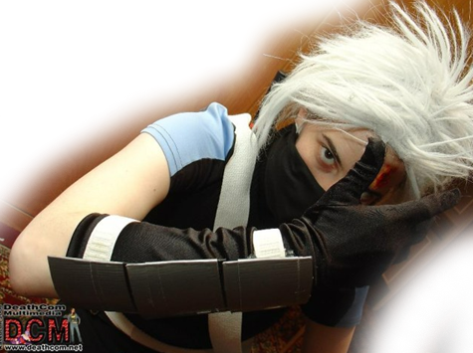

Budget accessories
Transform it! Thrift it!
Party beads and xmas garlands -> jewelry
Tupperware -> armor
Sports/safety equipment -> armor
Coat hangers, chopsticks, and sturdy sticks for hair accessories
Paper mache works too!
Xmas garland painted with metallic paint
Baseball helmet
Cloth shower curtain
Thrifted glasses
Baseball pants
Gardening gloves
Nightlight
Tupperware armor covered with duct tape
Notes:
Here are a few ideas of what you can start with, but it’s certainly not an exhaustive list. Browse thrift and craft stores, checking out what’s available
Use that transformation mindset. What has the right shape and size? What kinda looks like something completely different?
That’s the key to making transformation magic.

Slide 15


Full Example – Lulu from FFX
Best Advanced – KingCon 2020
Cost: $40-50
Hand-braided ponytail wig
Wooden bead
Borrowed plush
Faux fur couch throw
Wire coat hangers
Plastic from a box
Mini fabric flowers
Joann quilting cotton with coupon
Heavy curtains
Wooden chopstick from take-out
Lightweight air-dry clay
Thrifted marine vinyl
Thrifted lace trim
Eyelets bought in bulk
Strung party beads
Two thrifted tablecloths under train (protects it when walking)
Foam ‘buckles’
Notes:
Many of these items were thrifted or bought at Walmart
Others I’d bought in bulk and had on hand to reduce costs

Slide 16


Full Example – Link from Zelda BOTW
Chenille yarn bought on clearance at Michaels
Stash buster leftover faux fur
Judge’s choice, RCCC 2023
Cost: $40-50
Faux wholesale suede
Tissue box, wire, toilet paper rolls, and foil
Air-dry clay teeth
Taco boxes, wire, and foil
Strips of taco boxes, wire, and TP tubes
Vinyl tablecloth
Arda wig used in multiple cosplays
Amazon box, taco boxes, and wire
Stash buster suede cord originally bought in bulk
Stash buster leftover swimsuit lining and knit
Wooden craft bracelet from Walmart
Notes:
This is a stash buster project. I mostly used what I had already
All armor and accessories are made using paper mache
When I competed, I don’t think I heard a crowd scream louder for a cosplay made of taco boxes than when I wore this

Slide 17

Now go create a budget masterpiece
It’s easier than finding korok seeds
Find the slides at
https://leafnincosplay.com/panel-presentations/
Notes:
I hope you all learned a lot today!

